Slide 1
Databases
Session 14

Slide 2
Agenda
Part I
Types of databases
Relation model
SQL intro: creating a table, inserting data, simple queries
Part II
Data manipulation: insert, update, delete
Advanced queries: joins, group by
Normalization, Indexes, Transactions
Notes:
Duration: - 5 minutes

Slide 3
Types of databases
A organized collection of data
Databases are managed by DBMS (database management system)
Special software that sores the data and offers the user the possibility to modify and query it
Usually classified by how data is organized (database model)
The most used model is called “relational model”
In recent years a new type has emerged “NoSQL”

Slide 4
Relational model
The relational model was first described in the 70s
The main idea was to organize the data is such a way so it can be used (queried) in lots of different ways, serving different purposes
The systems that manage a relational database are called RDBMS (relational database management system)

Slide 5
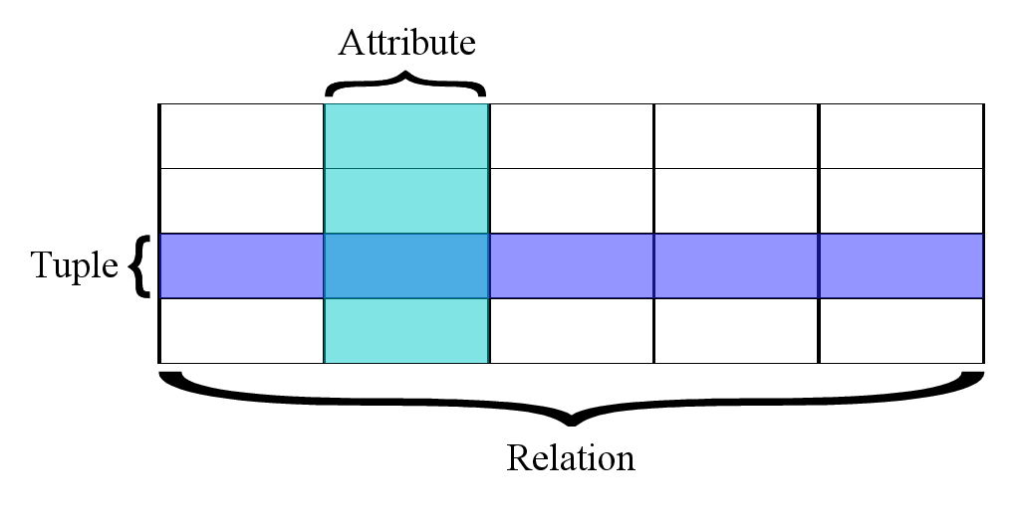
Relational model
In the relational model data is made of attributes (columns) organized in tuples (rows) that form relations (tables)

Slide 6
Relational model
A tuple (row) represents pieces of data (e.g.: person, book, product)
The relation (table) represents the set of all these entities (e.g.: persons, books, products)
Each tuple (row) has a priamary key that uniquely identifies it inside the table
A key is made of one or multiple attributes
There are two types of prinmary keys: natural and surrogate
Natural keys are existing attributes of a tuple (e.g.: CNP, ISBN)
Surrogate keys are “made up” unique attributes (e.g.: product id)

Slide 7
Relational model
A person relation (table)
Person ID is a surrogate key
Person ID | Name | Address | Phone
1 | Jon Snow | Independentei, nr. 1, Iasi | 0123456789
2 | John Doe | Who Knows, nr. 1, Nowhere | 0000000000

Slide 8
Relational model
Data in different relations (tables) can be cross-referenced
An attribute in a table can contain the value of a primary key in another table
Such an attribute is called a foreign key

Slide 9
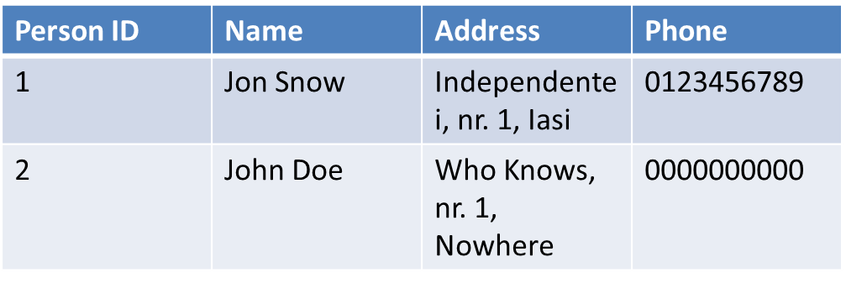
Relational model
Persons:
Books:
The “Author” attribute from the books table is a foreign key to the “Person ID” primary key from the person table
Book ID | Title | Author
11 | The Unknown | 2
22 | In the Black | 1

Slide 10
Java DB
The JDK comes with a RDBMS called “Java DB”
You can find it in JAVA_HOME/db
Can be used as a library or as a standalone server
Starting the server: JAVA_HOME/db/bin/startNetworkServer
It also include a command line client called ij
Starting the client: JAVA_HOME/db/bin/ij

Slide 11
Java DB
A RDBMS usually manages multiple databases
In Java DB a database is created by passing a special parameter when connecting to the server
CONNECT 'jdbc:derby://localhost/database_name;create=true';

Slide 12
SQL Intro
SQL stands for Structured Query Language
Is a declarative programming language aimed at managing and querying data stored in relational database
It contains three sub-languages:
Data definition language
Data manipulation language
Data control language
The syntax is made of statements separated by semicolons

Slide 13
SQL Intro
Data definition statements:
CREATE TABLE, DROP TABLE, ALTER TABLE
Data manipulation statements:
SELECT, INSERT, UPDATE
Data control statements
GRANT, REVOKE

Slide 14
SQL Intro
Tables (along with columns and attributes) are created using the CREATE TABLE statement:
CREATE TABLE Persons (id INT PRIMARY KEY, name VARCHAR(50), address VARCHAR(100), phone VARCHAR(14));
The create table statement specifies the table name, the name of all columns and their data types
Data types are usually specific to each RDBMS, but a common set is usually present in all of them
BOOLEAN, INTEGER, DECIMAL, VARCHAR, TIMESTAMP

Slide 15
SQL Intro
Inserting data is done with the INSERT statement
INSERT INTO Persons (id, name, address, phone) VALUES (1, “Jon Snow”, “The Wall”, “001”);
INSERT INTO Persons (id, name, address, phone) VALUES (2, “John Doe”, “Nowhere”, “000”);

Slide 16
SQL Intro
Data querying is done with SELECT:
SELECT id, name, address, phone FROM Persons;
SELECT id, name, address, phone FROM Persons WHERE name=“Jon Snow”;
SELECT * FROM Persons;

Slide 17
Data manipulation
Inserting data INSERT INTO tableName [ ( simpleColumnName [ , simpleColumnName ]* ) ] query
Where query can be: - a selectExpression - a VALUES expression - DEFAULT
And where VALUES expression is: VALUES ( value [ , value ]* ) [ , ( value [ , value ]* ) ]*

Slide 18
Data manipulation
Updating data UPDATE tableName SET columnName = value [ , columnName = value ]* [ WHERE clause ]

Slide 19
Data manipulation
Deleting data DELETE FROM tableName [ WHERE clause ]

Slide 20
Data manipulation
Query SELECT [ DISTINCT | ALL ] selectItem [ , selectItem ]* FROM clause [ WHERE clause ] [ GROUP BY clause ] [ HAVING clause ] [ ORDER BY clause ]
WHERE booleanExpression
GROUP BY columnName [ , columnName ]*
HAVING booleanExpression
ORDER BY { columnName | columnPosition | expression } [ ASC | DESC ] [ NULLS FIRST | NULLS LAST ] [ , columnName | columnPosition | expression [ ASC | DESC ] [ NULLS FIRST | NULLS LAST ] ]*

Slide 21
Data manipulation
FROM statement FROM tableExpression [ , tableExpression ]*
Where tableExpression is: tableName | viewName | tableSubquery | join
And join is: tableExpression JOIN tableExpression ON booleanExpression

Slide 22
Data manipulation
Types of JOIN:
INNER JOIN
LEFT OUTER JOIN retains the element from the left table that do not match elements in the right
RIGHT OUTER JOIN retains the element from the right table that do not match elements in the left
CROSS JOIN Cartesian product
NATURAL JOIN the join is done based on common columns

Slide 23
Normalization
The process od removing redundant data
There are three normal forms: first , second and third
With the third normal form being the most redundancy free

Slide 24
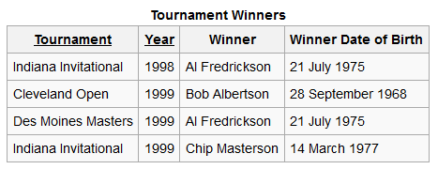
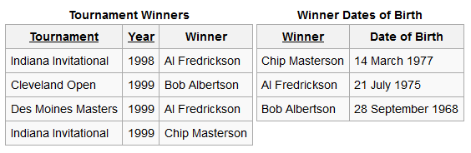
Normalization

Slide 25
Indexes
An index is a special data structure that improves the speed of data retrieval operations
Redundant data is kept in order to locate data without searching the entire database
Usually implemented with balanced trees, B+ trees, hashes

Slide 26
Transactions
A transaction is a logical grouping of database actions
Usually in RDBMS’s it obeys the ACID rues:
Atomic All actions are completed or none
Consistent After completion the database will be in a consistent state (all constrains will be met)
Isolated Each transaction is executed as if no other transaction takes place at the same moment
Durable After completion the data is guaranteed to be saved

